Slide 1
Designing a Database
Queens College Class Schedule
Notes:
Hello! My name is Jasmine Kim and I took a Database course at Queens College last semester with professor Peter Heller. I am going to present the final project and what I learned from it. I had to design a database made up of multiple tables from scratch based on raw, unorganized data.

Slide 2
Project Goals
Flat File -> Database
Normalization/Relationship between the tables
Data Cleansing
User Defined Data Types (UDT)
Data Integrity: Constraints
Stored Procedures- Insert data into individual tables
Queries that support the design (Using JDBC & Jtable)

Slide 3
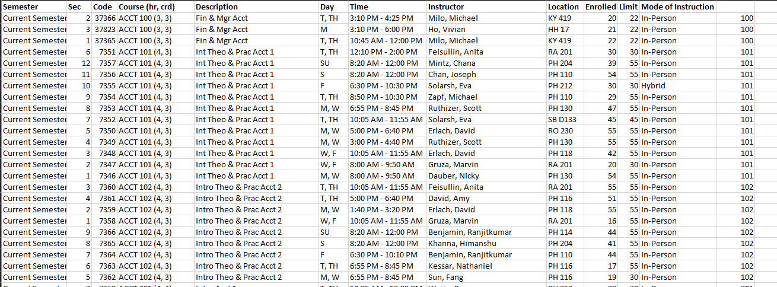
Flat File
Notes:
Flat file: raw, unorganized data. No relationships.

Slide 4
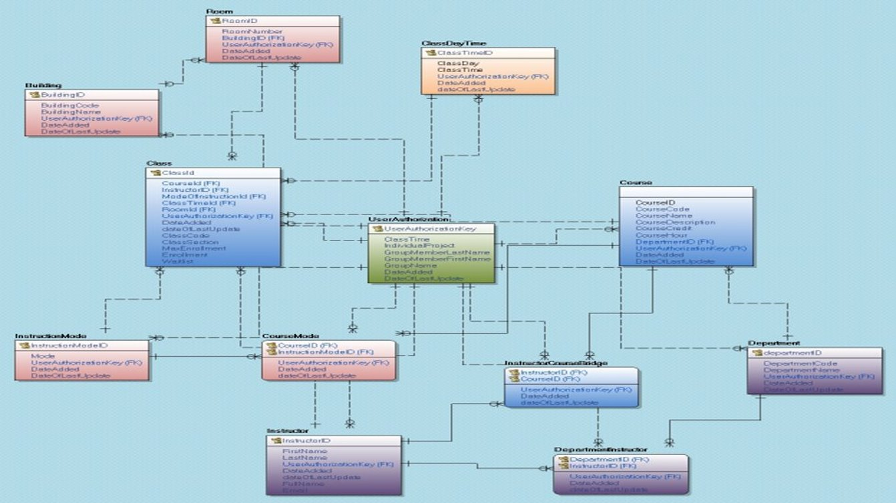
Final Database Diagram

Slide 5
Normalization
Separating the one table into multiple tables to reduce data redundancies and insert, delete, and update anomalies.
Removing partial and transitive dependencies. Fulfill up to 3rd normal form.
Locate which columns are functionally dependent on which primary key column?
Determine the relationships between the tables. Child? Parent? Which table references which table? One to Many, Many to Many relationships (Bridge Table).
Notes:
One example would be course description column would be functionally dependent on the courseID.

Slide 6
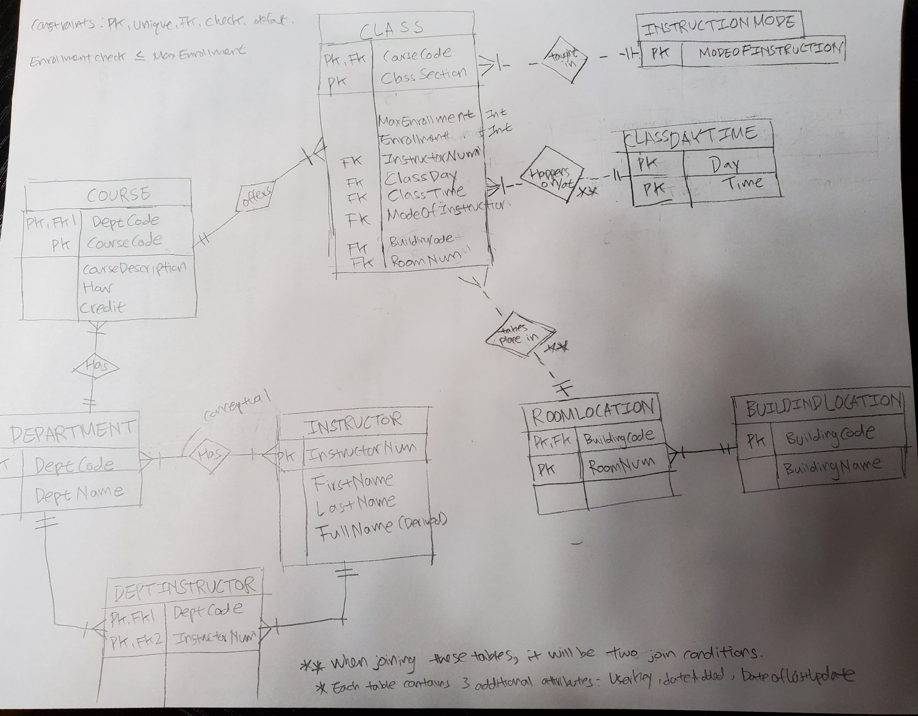
Mix of Chen Notation and ERD Diagram (Work in Progress…)
Notes:
This was my 3rd draft of the database. It has a mixture of chen notation and ERD diagram so it is not correct. It was work in progress. I repeatedly had to revise the lines between the tables to sort out the relationships between. Who becomes parent and child? Which additional tables need to be created to avoid redundant data? I think I spent about 4 days on this. I did not want to start creating a database and then have to keep fixing it. I figured I need a clear map before creating any physical tables. I still ended up having to go back and forth many times but I was glad I did this process before. I guided the rest of my project.

Slide 7
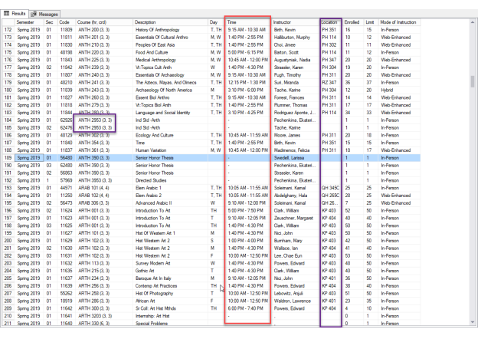
Data Cleansing
Removing the empty/null cells.
Atomizing columns with composite data.
Notes:
First step of normalization is removing empty or null cells. It is hard to normalize the database when not all data is present.

Slide 8
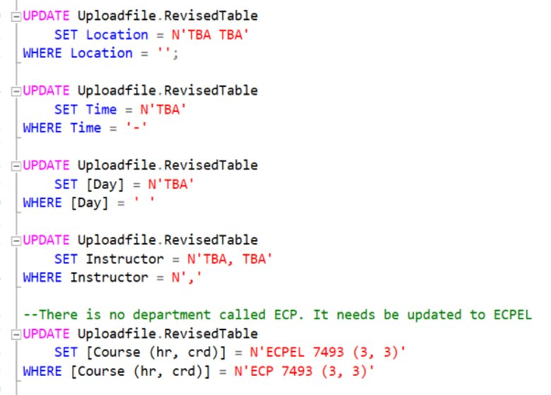
Data Cleansing
Notes:
These are a series of update statements I performed in order to remove empty data.

Slide 9
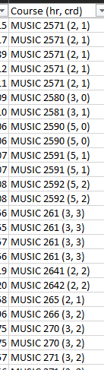
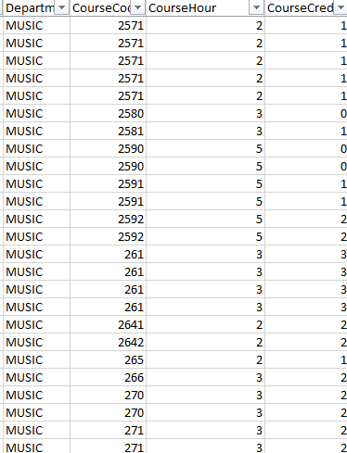
Atomizing A Composite Column
Notes:
I divided a column with multiple information into separate columns. This way, when we insert the data, we can easily refer to a column.

Slide 10
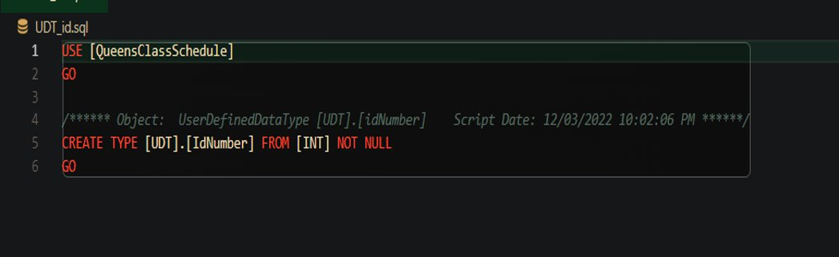
User Defined Data Types
Notes:
User Defined Data Types (UDT) are useful because they allow encapsulation, reusability, and flexibility. It will always have the same definition, default values, and value constraints regardless of where it appears in the database. So it makes the database more uniform and consistent. There may be the type of data that company uses often so it can always refer to this datatype once it is created. It also has flexibility in that it allows the database object designer to model the real world as it exists.

Slide 11
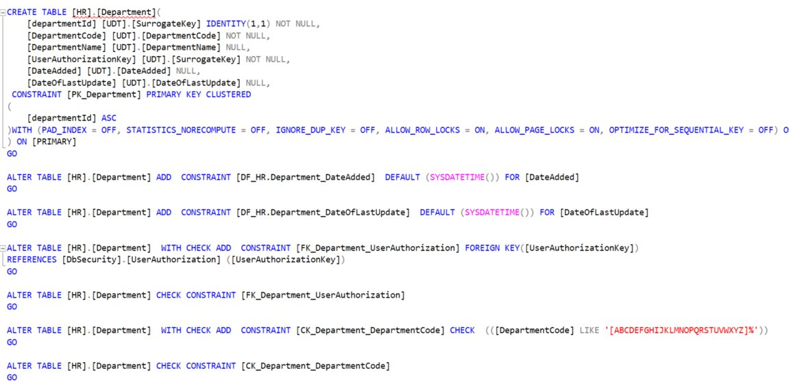
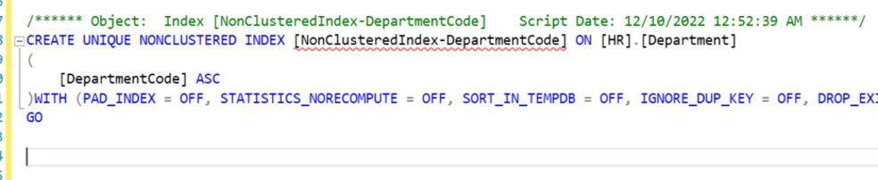
Department Table Example
Notes:
UDT and Constraints. Notice that all of the columns use the UDT that have been defined previously. There is a check on the department code that it should always start with a capitalized alphabet. In ensures data integrity. Here, I created a nonclustered index for the department code to ensure uniqueness and to allow faster lookup based on departmentcode such as ACCT instead of departmentID 1. ACCT is usually meaningful to our minds so it may be used more often in our queries.

Slide 12
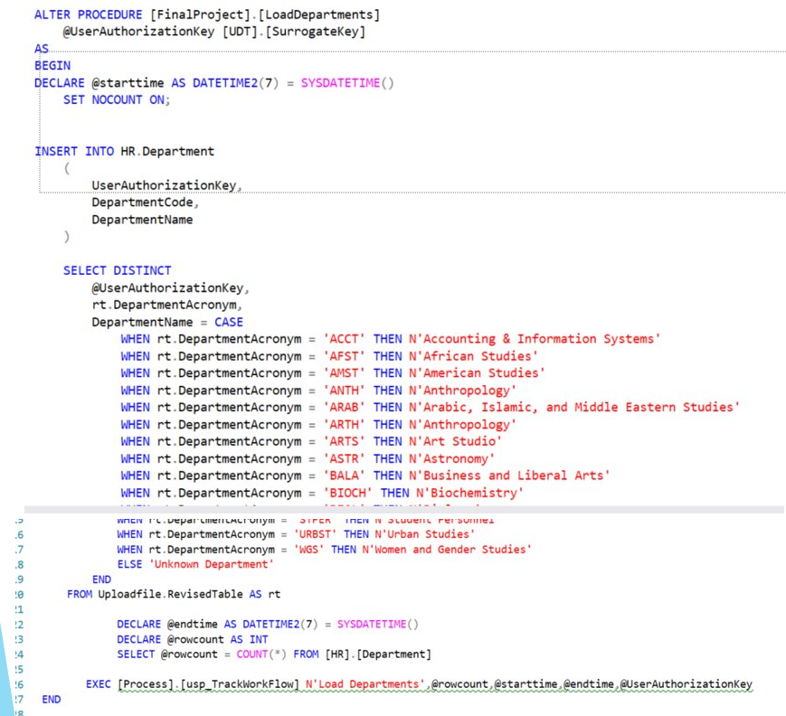
Department Table Stored Procedure
Notes:
Here is an example of inserting data. Once the table was created with its definition, now, it needs to be filled with actual data. By using a case statement, department description was added along with the department code.

Slide 13
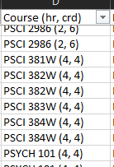
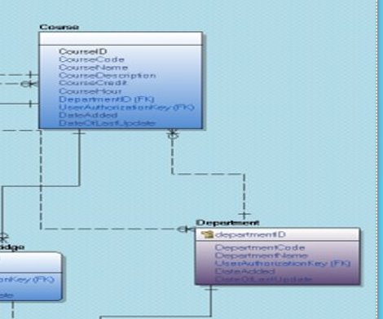
Course Table
Notes:
I want to share several thoughts I had when formulating the relationships between the tables. I noticed that a course name is made up of the combination of department code and the number. So I created the relationship so that course references the departmentId.

Slide 14
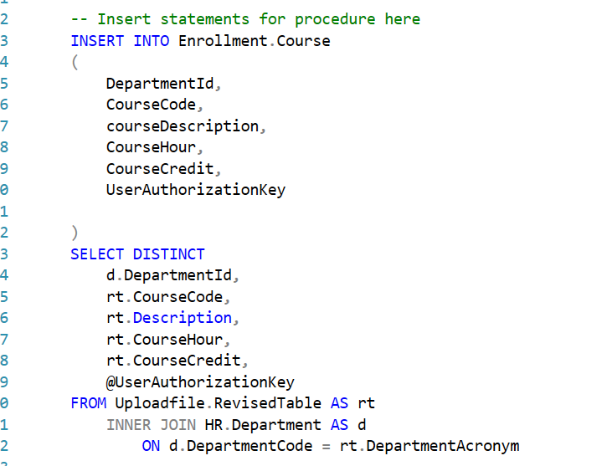
Course Table Stored Procedure
Notes:
Notice there is an inner join with the department code. Course name is made up of department code and is therefore dependent on it to give it an individual identity.

Slide 15
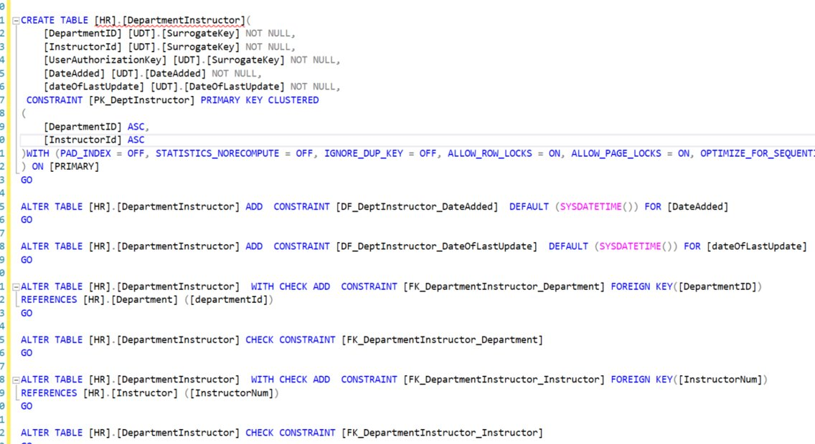

DepartmentInstructor Bridge Table
Notes:
I learned about the need for bridge tables/association tables. Physical databases do not support many to many relationship. An example is department and instructors. A Department has many instructors and instructors can be a part of many departments. To support this many to many relationship, a lookup table is necessary. Notice the composite primary keys made up of foreign keys from the Department and Instructor tables. Since the primary keys depend on other tables, this bridge table is a weak entity. It also has a strongly identifying relationship with the other two tables since it explicitly makes the primary keys based on the columns it is referencing. The index allows for a faster look up. The clustered index already creates the lookup from department to instructor. So to allow an efficient lookup from the other direction, I’ve created an alternate index out of the reverse direction: InstructorId and DepartmentId.

Slide 16
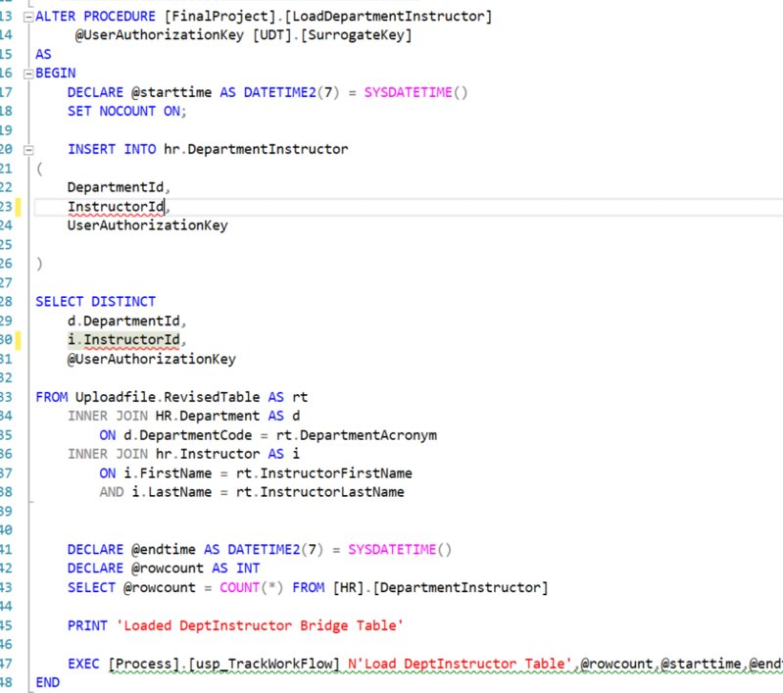
Notes:
Here is the stored procedure of the bridge table. Notice that two INNER JOINs were performed to gather data from both tables. It is the LOOKUP table that connects both tables.

Slide 17
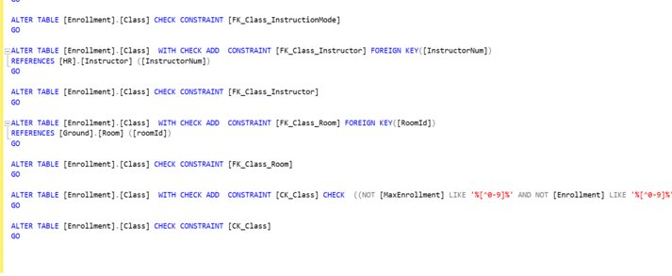
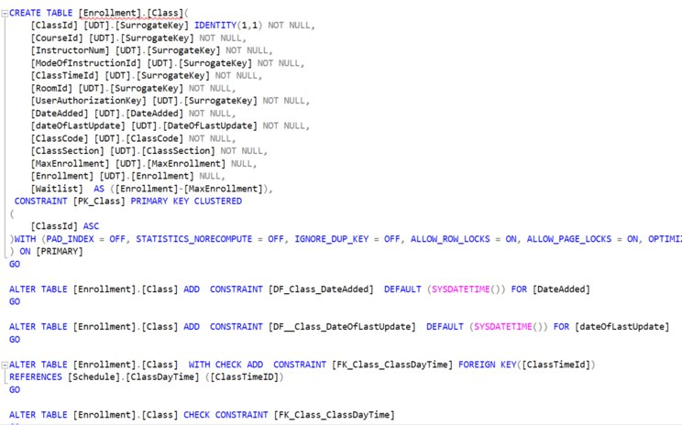
Class Table
Notes:
As you saw in the rough draft ERD, CLASS was in the center. It served as a child to many different tables. It is an example of multiple inheritance. It references many other tables. Therefore, you will see that there are many foreign key constraints in this table definition. A check was done to ensure that max enrollment and enrollment number are made up of only numbers.

Slide 18
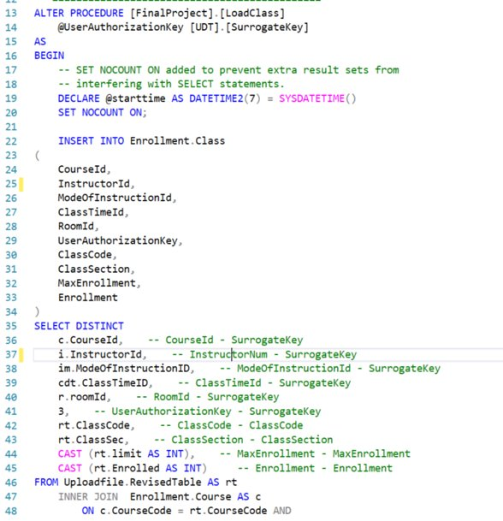
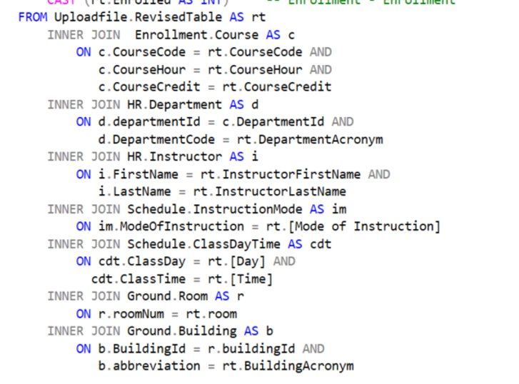
Class Table
Notes:
Stored procedure of class table. As expected, many joins are performed to reflect its relationships to other tables.

Slide 19
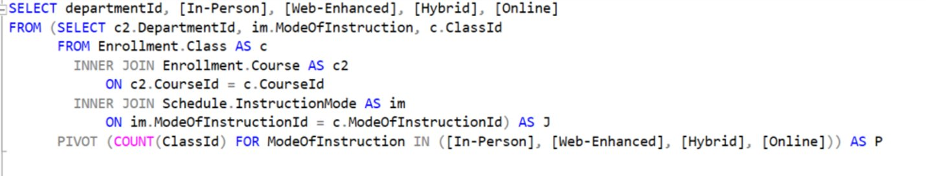
Proposition: Obtain a pivot table on how many of each mode of instruction are being offered by each department.​
Notes:
Pivot table is good for data analysis and reporting. How many classes are offered in-person, online, etc by each department? DepartmentId is accessible by the relationship between class and the course table. Course table has departmentId as a foreign key. Class is in between mode of instruction and course tables.

Slide 21
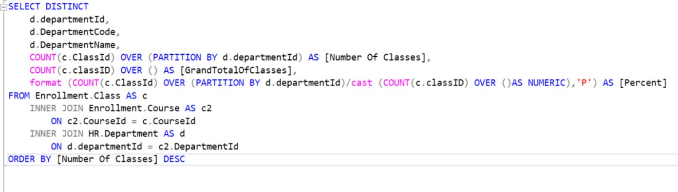
Proposition: How many classes are offered by each department? Obtain the percentage of the current value out of the grand total.​
Notes:
Class is the child, course parent, and department is the grandparent. Because I set up the relationship like this, these inner joins were necessary to obtain the information.

Slide 22
Summary and Thoughts…
Notes:
Building a database was a challenging task. Thankful to someone who thought of normalization techniques to avoid duplicate and data anomalies. There are many tools to ensure data integrity such as setting the data domain and constraints. Also realized that creating relationship between the table depends heavily on the business practice. Increasing an efficiency of lookup by creating alternate indexes is very practical tip. Numerous bridge tables can be created among these tables but is there a need if we never have to query the relationship between the tables? This emphasizes the importance of understanding the business will help you design a database that is more useful to the database and help the business become more efficient. I also learned firsthand what kinds of considerations data scientists’ have when designing a database.

